Slide 1

Project 1 Assessment : Forest Management System
Wenqiao Qin
Letian Yang
Hanze Li

Slide 2
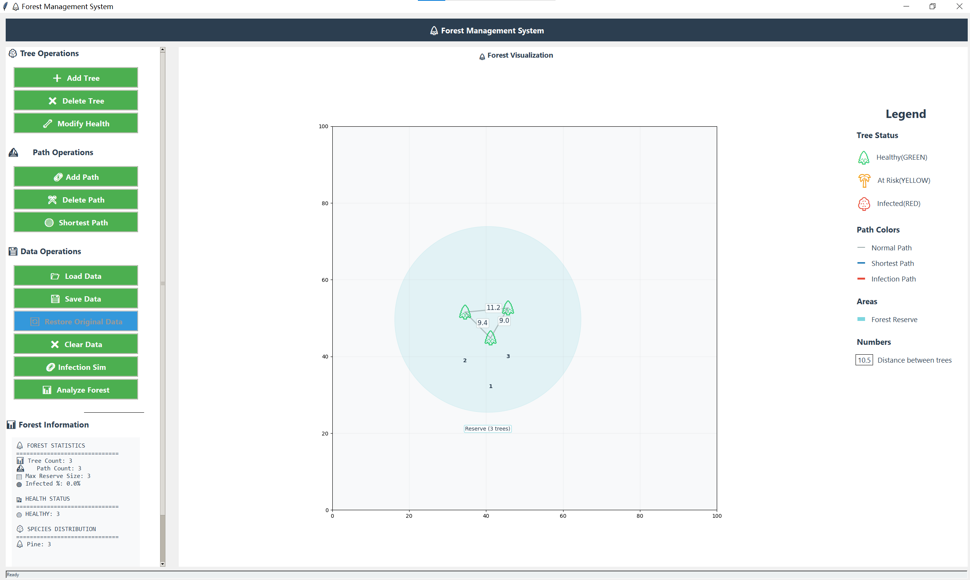
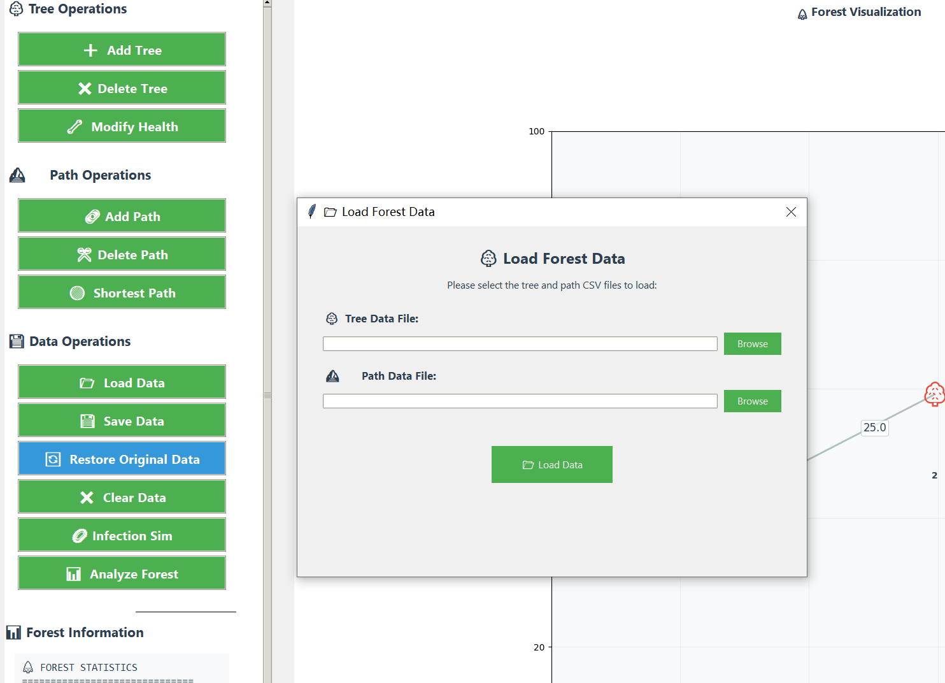
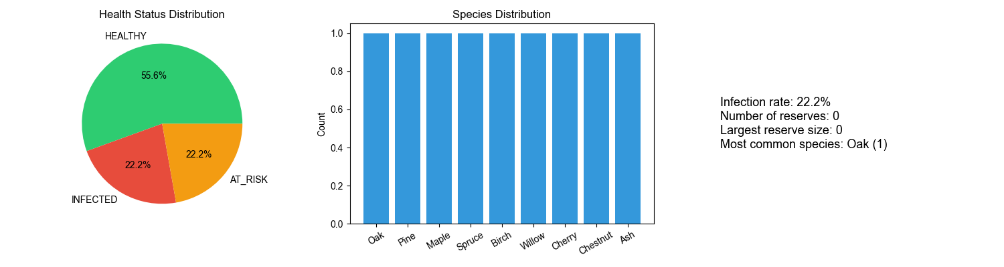
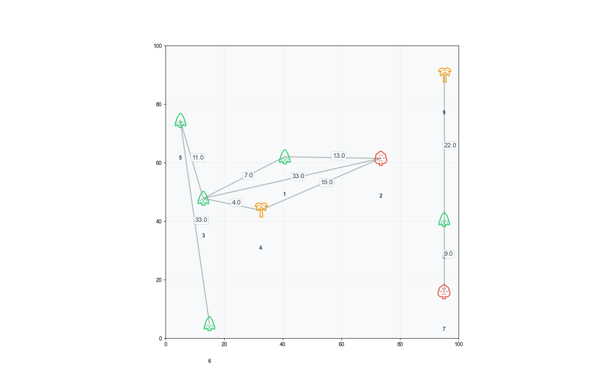
Presentation Outline
1. Project Overview
2. System Architecture
3. Core Features Demonstration
4. Technical Highlights
5. Difficulties faced and solved
6. Future Prospects
7. Project Summary

Slide 3

Project Overview
Project background
Project objectives
Project achievements
Team members and roles

Slide 4

Project background and objectives
Project Background:
This system aims to address real-world challenges in forest ecosystem management and analysis. It provides a comprehensive tool for visualizing and analyzing forest data, aiding in decision-making related to forest conservation and management.
Project Objectives:
Develop a user-friendly application that allows users to manage tree data, simulate disease spread, find optimal paths between trees, and detect forest reserves.
Implement advanced algorithms for forest analysis and provide a modern graphical user interface to enhance user interaction.

Slide 5
Project Achievements
🌲 Tree Data Management:
Implemented features for adding, deleting, and modifying trees, allowing users to manage forest tree data through an intuitive interface.
🛤️ Path Management:
Enabled path addition and deletion, allowing users to easily manage connections between trees and optimize forest resource utilization.
📊 Data Import/Export:
Supported CSV format for data import and export, ensuring data standardization and portability.
🔍 Shortest Path Algorithm:
Implemented Dijkstra's algorithm to find the shortest path between trees, helping users quickly identify optimal routes.
🦠 Infection Simulation:
Simulated disease spread in the forest using Distance-based priority queue, aiding users in predicting and managing potential disease risks.
🛡️ Reserve Detection:
Implemented DFS-based reserve detection to automatically identify and highlight connected forest reserves.
🎨 Modern GUI Interface:
Provided an intuitive Tkinter interface, allowing users to interact with the system through interactive elements and custom styling.

Slide 6
Team members and roles
Letian Yang
Hanze Li
Wenqiao Qin
Responsible for developing the main algorithms
building the toolbox.
Conducted project testing
UI improvements.
Authored the presentation and report
Focused on UI design
code testing and fixing.
Contributed to report writing.
Code packaging
responsible for report writing.

Slide 7

System Architecture

Slide 8
Core components
🌳 Data Structure
📂I/O Functionality
🧠Algorithm Modules
🖥️GUI Components
🌲Forest graph 🌳 Tree
🛤️ Path 🩺 Health Status
📂 Dataset Loader
🔍 Pathfinding Algorithm 🦠 Infection Simulation
🛡️ Reserve Detection 🧲Force-Directed Layout
🖥️ Main Application Window 🖼️ Forest Canvas
🎛️ Control Panel 💬 Dialogs and Forms

Slide 9
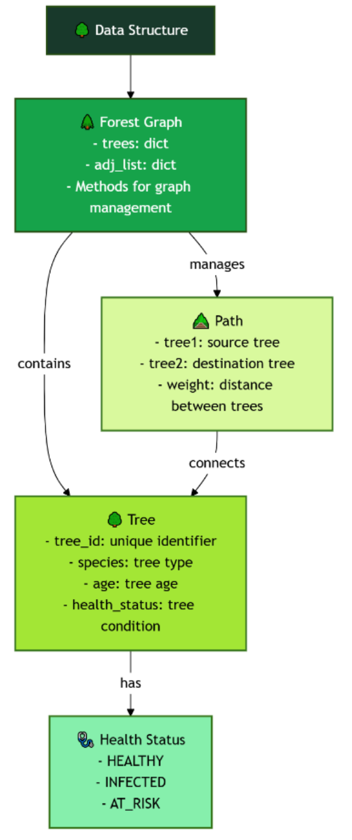
🌳 Data Structure
🌲 Forest Graph: The central data structure representing the entire forest.
Implemented using an adjacency list for O(1) query performance
Manages trees and the connections between them
Provides methods for adding, removing, and querying trees and paths
🌳 Tree: Represents individual trees in the forest with the following attributes:
Tree ID (unique identifier)
Species
Age
Health status (Healthy, Infected, At Risk)
🛤️ Path: Represents connections between trees
Contains references to two tree objects and a weight (distance)
Used for calculating routes and simulating disease spread
🩺 Health Status: Enumeration representing possible health states of trees
HEALTHY, INFECTED, AT_RISK
Used for visual coding and algorithm decisions

Slide 10
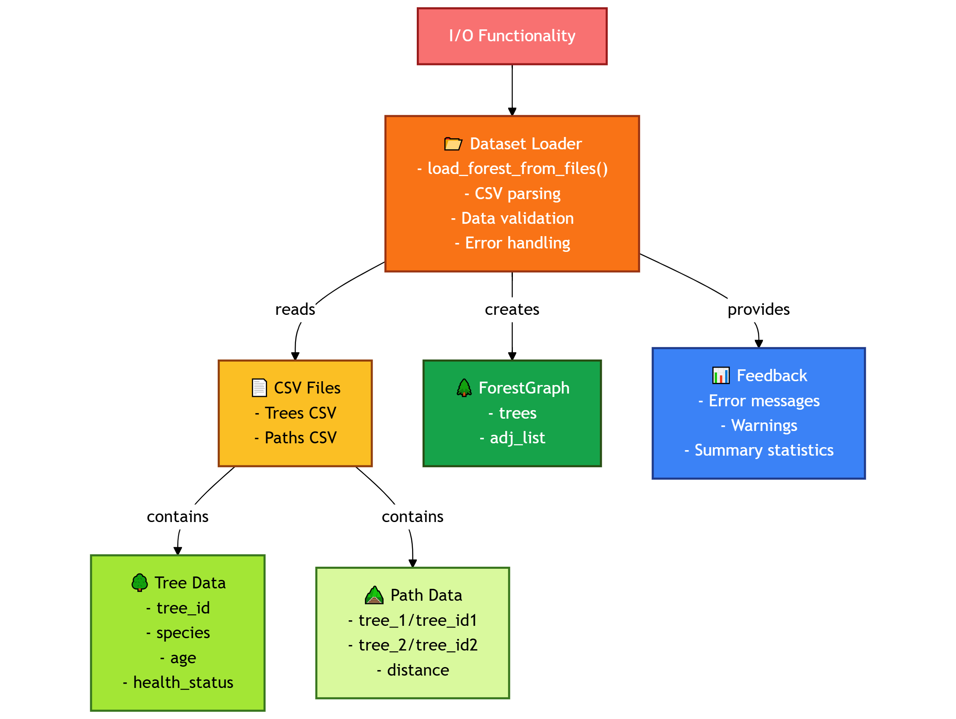
📂I/O Functionality
📂 Dataset Loader: Handles data import and export for the forest management system.
Loads forest data from CSV files with enhanced error handling
Validates columns and data formats before processing
Detects and reports duplicate tree IDs, missing values, and format issues
Creates a complete ForestGraph structure from raw data
📊 Key Features:
CSV Processing: Supports standard format for tree and path data
Error Handling: Comprehensive validation with detailed error messages
Data Transformation: Converts raw data into Tree and Path objects
User Feedback: Provides informative messages about loading status
💾 Data Format Support:
Trees CSV: Handles tree_id, species, age, and health_status columns
Paths CSV: Supports multiple naming conventions (tree_1/tree_id1) for flexibility
Validation Rules: Enforces data integrity (no self-loops, positive distances, etc.)

Slide 11
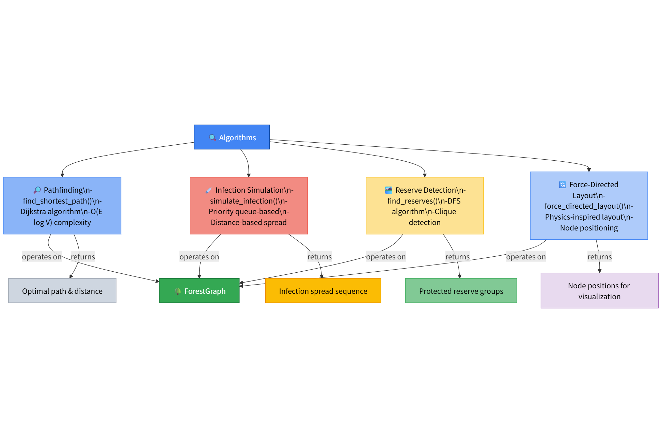
🧠Algorithm Modules
🔍 Pathfinding Dijkstra’s algorithm with priority queue
O((V+E)log V) complexity
Finds shortest path between trees
🦠 Infection Simulation Distance-based priority queue
Simulates disease spread by proximity
🛡️ Reserve Detection DFS for connected components
Finds healthy tree cliques, avoids infected/at-risk trees
🧲 Force-Directed Layout Physics-inspired node positioning
Visually organizes trees for clear display
🖋️ Key Features All algorithms use ForestGraph
Optimized with priority queues
Results ready for visualization
Modular and easy to maintain

Slide 12
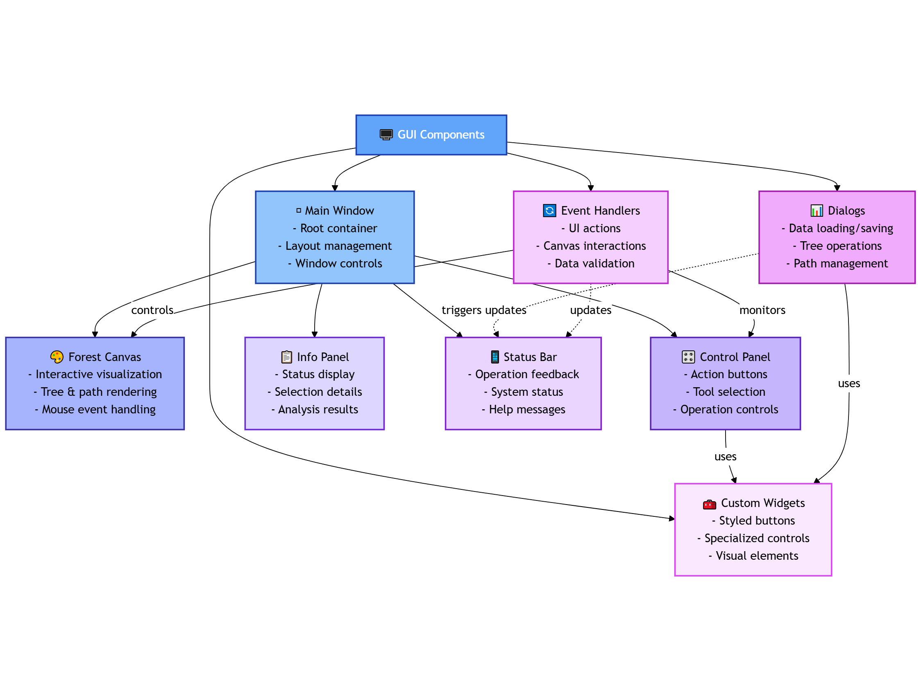
🖥️GUI Components
🖥️ Main Window
Central container for all UI elements
Manages layout and component organization
🎨 Forest Canvas
Interactive visualization of forest graph
Tree and path rendering with color coding
Mouse event handling for user interaction
🎛️ Control Panel
Action buttons for core operations
Organized by function groups (trees, paths, algorithms)
📋 Info Panel
Displays selection details and results
Shows algorithm outputs and statistics
📊 Dialogs
Data loading/saving interfaces
Tree and path operation forms
🔄 Event Handlers
Process UI interactions
Connect interface to core functionality

Slide 13
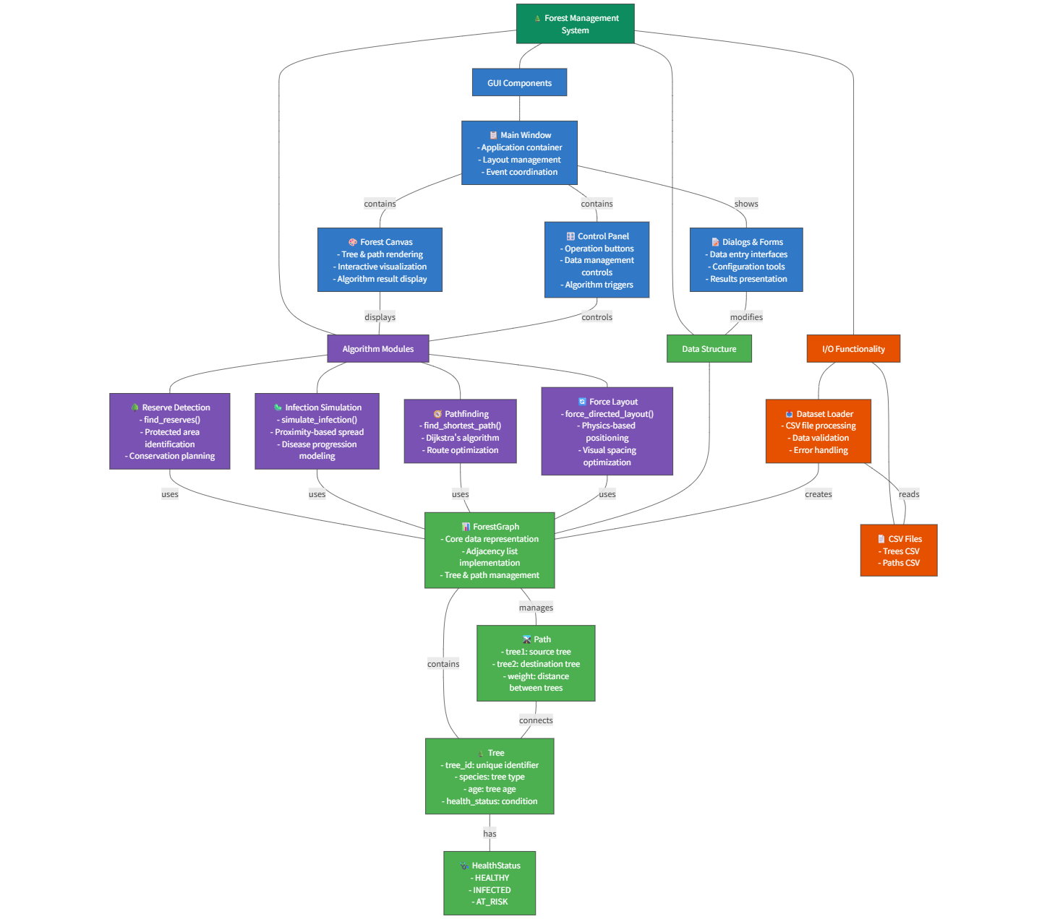
System diagram

Slide 14
Core Features Demonstration

Slide 15
🖥️GUI
All trees can be moved, and the distance changes accordingly
Basic function
Legend
(also overcome cross-platform issues)
Complications
Analysis

Slide 16
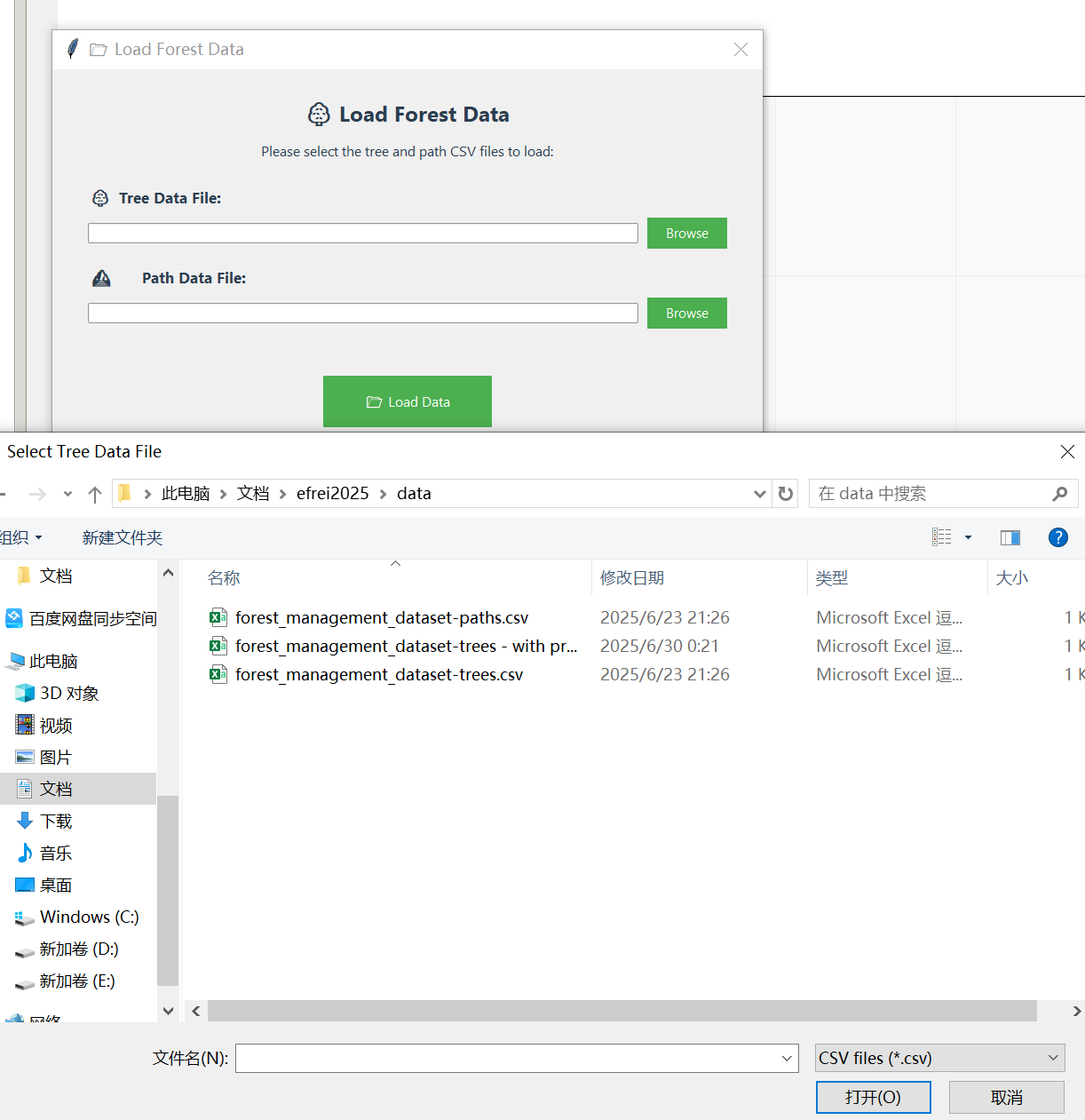
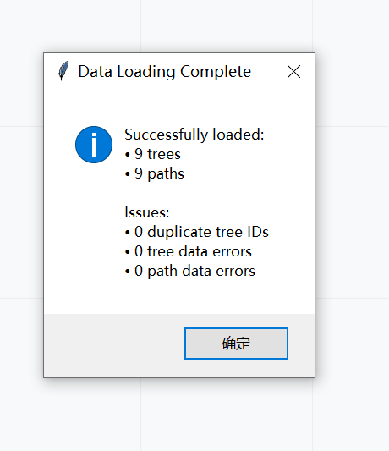
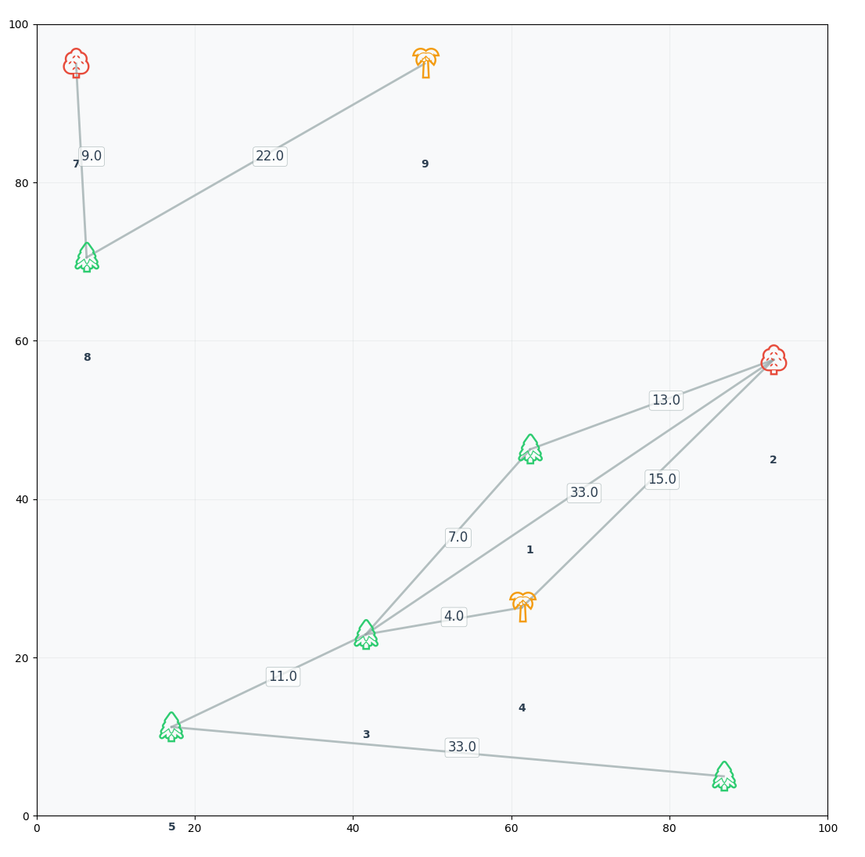
🖥️GUI(I/O success)
SELECT FOLDER
Status Report
GRAPH LOADED

Slide 17
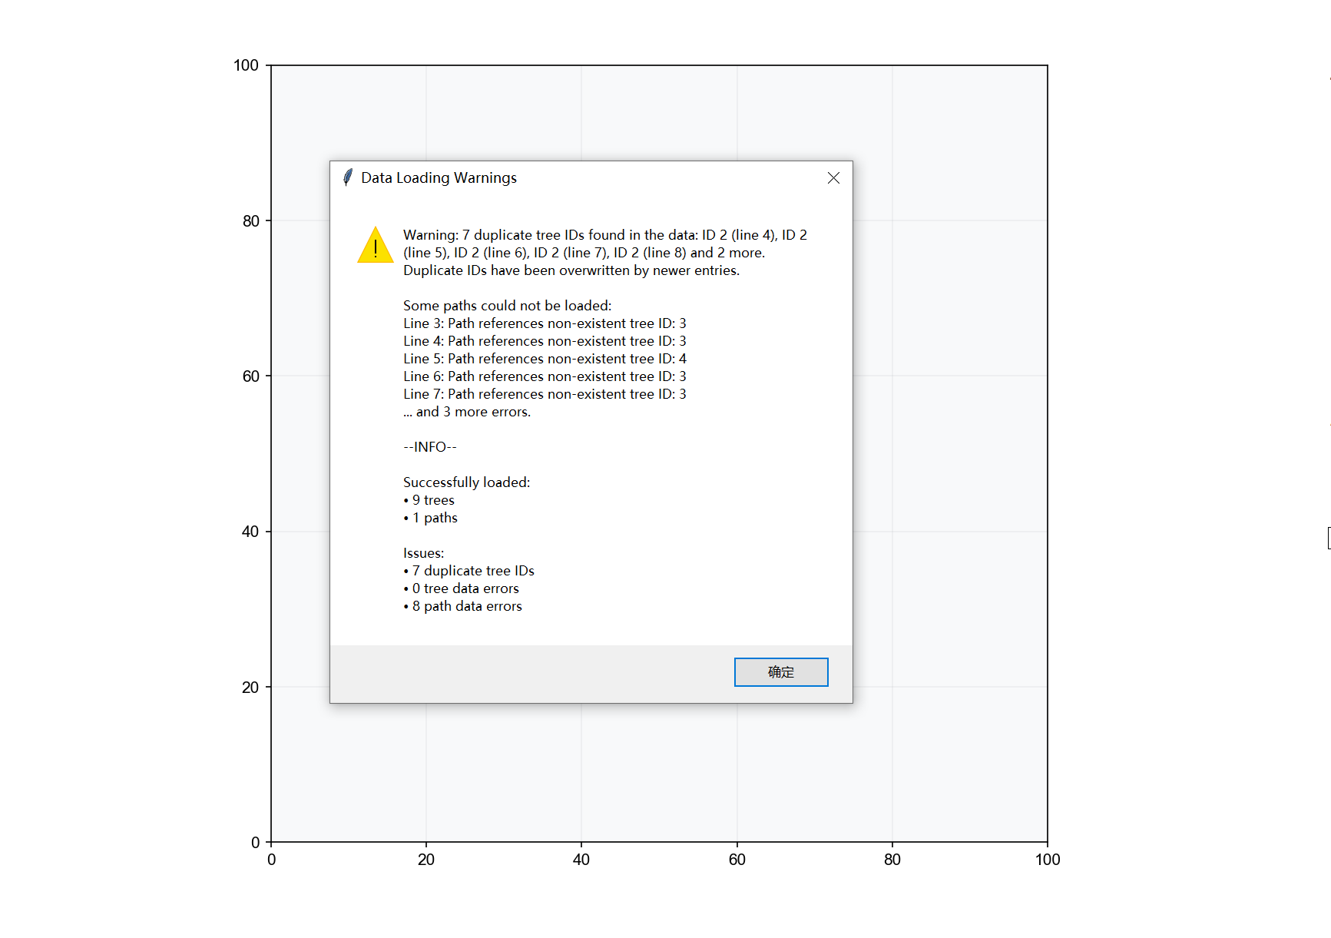
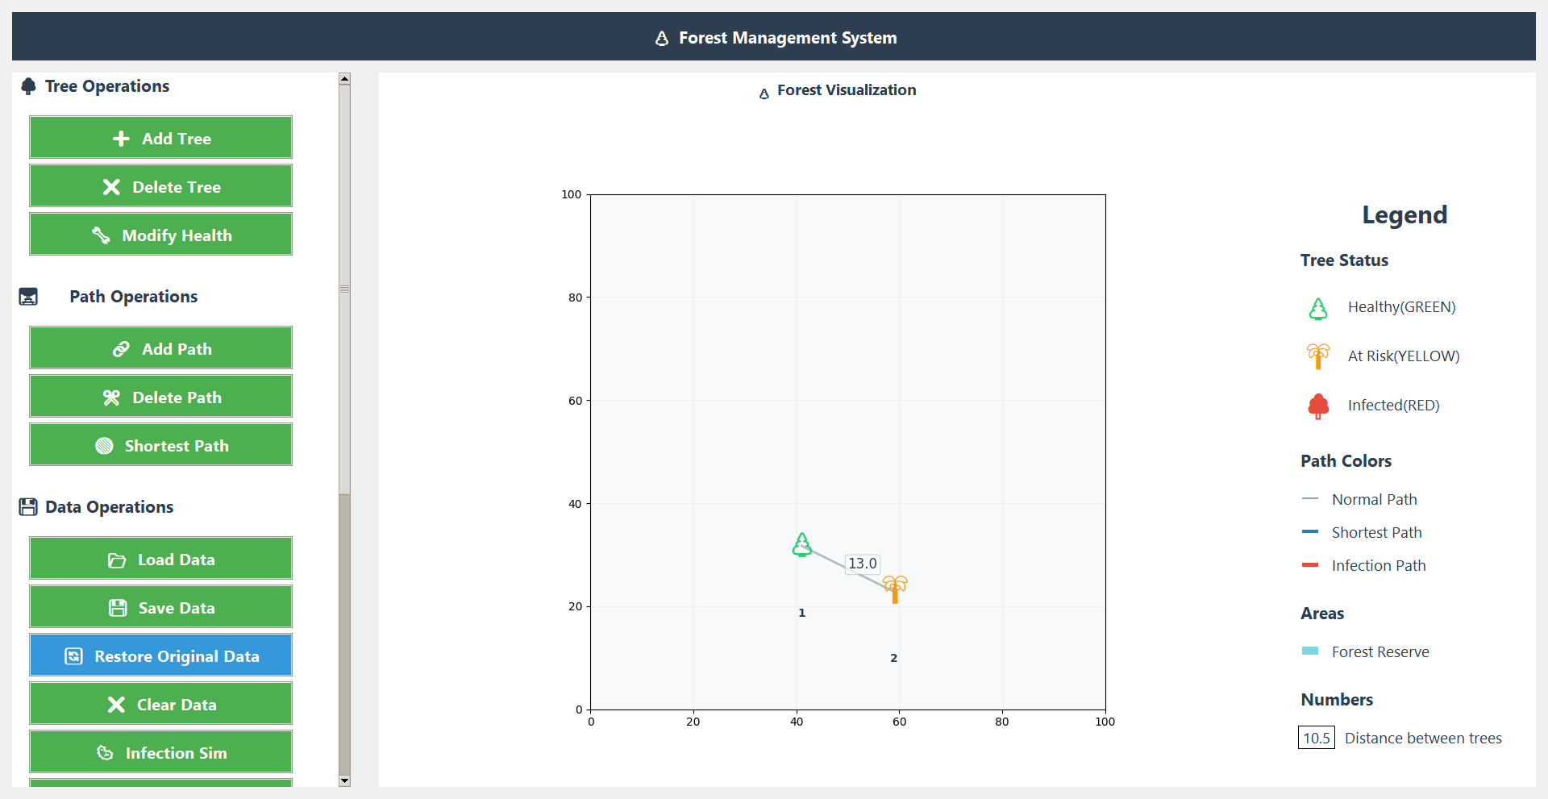
🖥️GUI(I/O error)
Status Report
Graph loaded

Slide 18
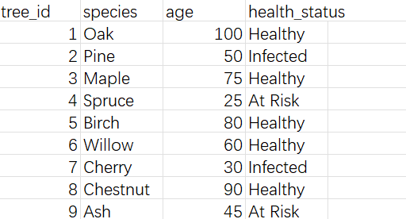
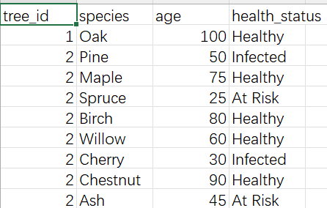
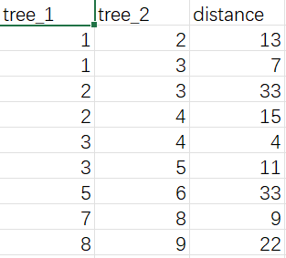
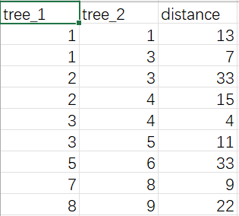
🖥️GUI(I/O csv format)
Right format
False format
❌
❌

Slide 19
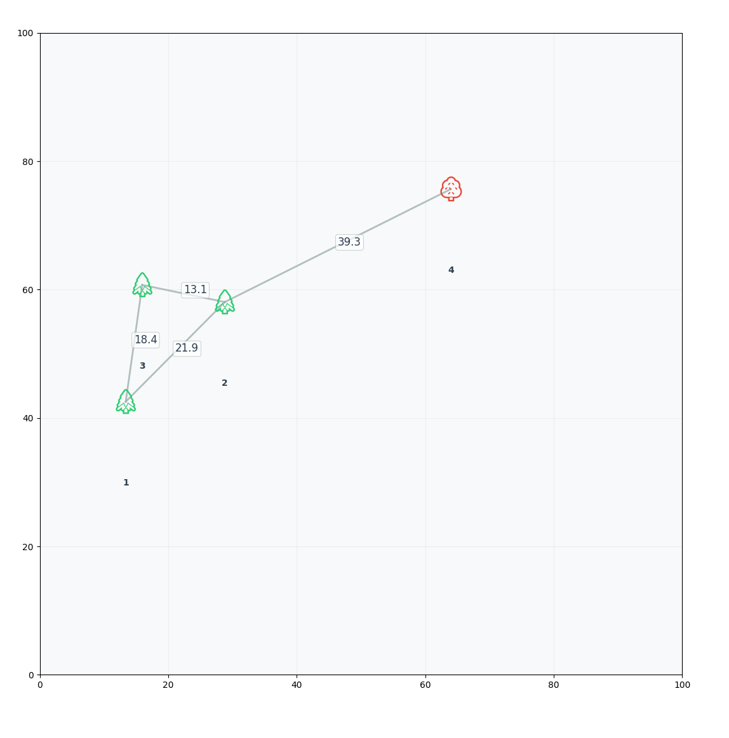
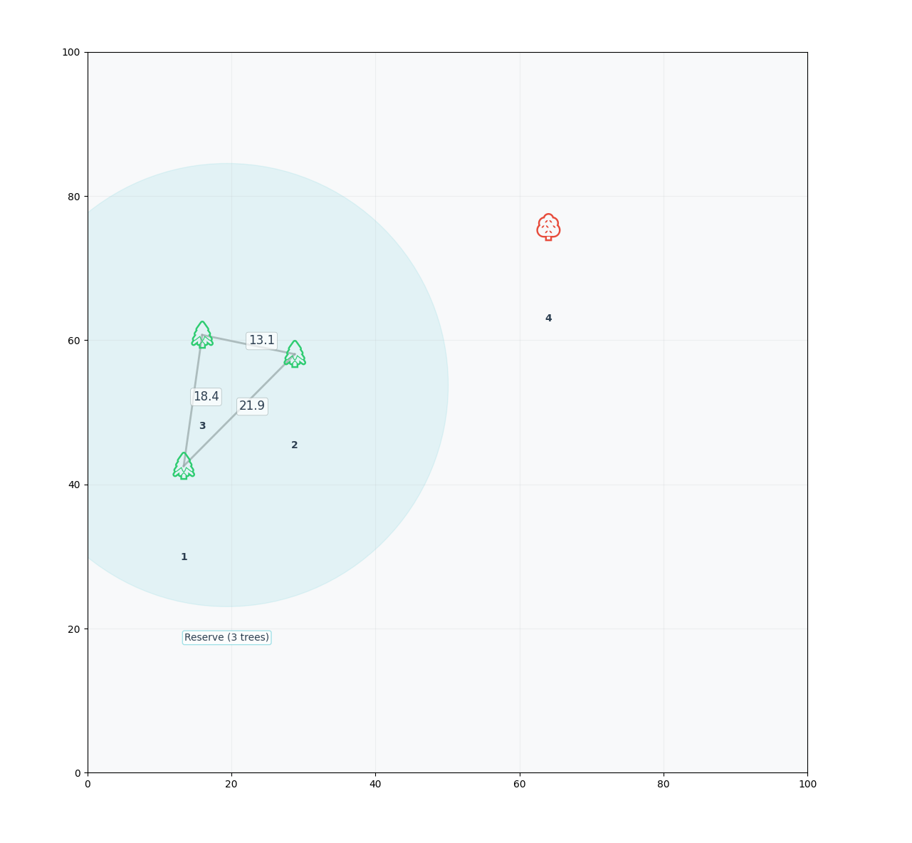
🖥️GUI(Conservation Areas)
Reserve
(Fully connected diagrams)
DFS
❌

Slide 20
🖥️GUI(Conservation Areas)
Why DFS?
Find Connected Components:
DFS is ideal for finding all healthy trees that are directly or indirectly connected, grouping them into “connected components.” This matches the definition of a reserve.
Efficiency:
DFS visits each node and edge only once, making it fast (O(N+E)) and suitable for large graphs.
No Duplicates or Misses:
By marking visited nodes, DFS ensures every healthy tree is checked exactly once—no repeats, no omissions.
Easy to Implement:
Recursive DFS code is simple and clear for grouping nodes.
Prepares for Further Checks:
After grouping, it’s easy to check if the group forms a clique and is isolated from unhealthy trees.

Slide 21
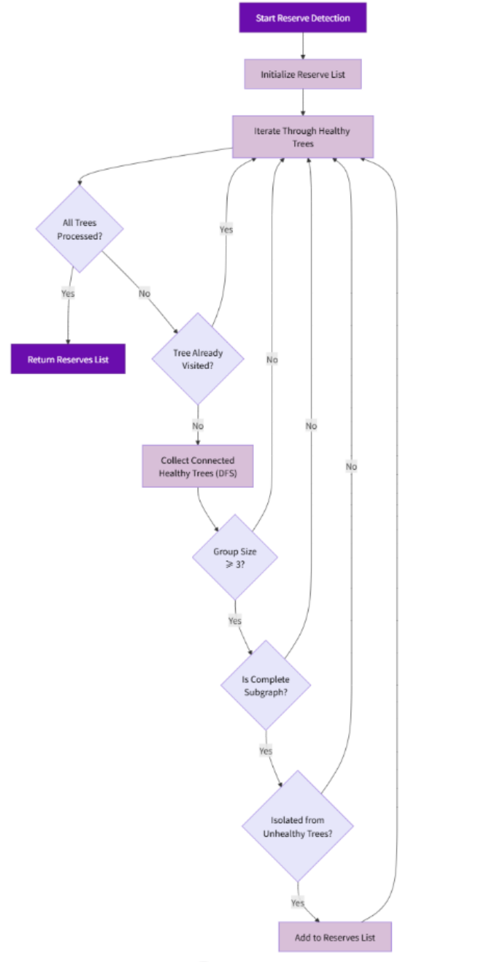
Conservation Areas
Start:
Begin reserve detection.
Init:
Create an empty list to store reserves
Loop:
For each healthy tree:
If already checked, skip.
Use DFS to find all connected healthy trees (group).
If group has less than 3, skip.
If not all trees in group are directly connected, skip.
If any tree in group touches an unhealthy tree, skip.
Otherwise, add group to reserve list.
End:
Return the list of reserve sets

Slide 22
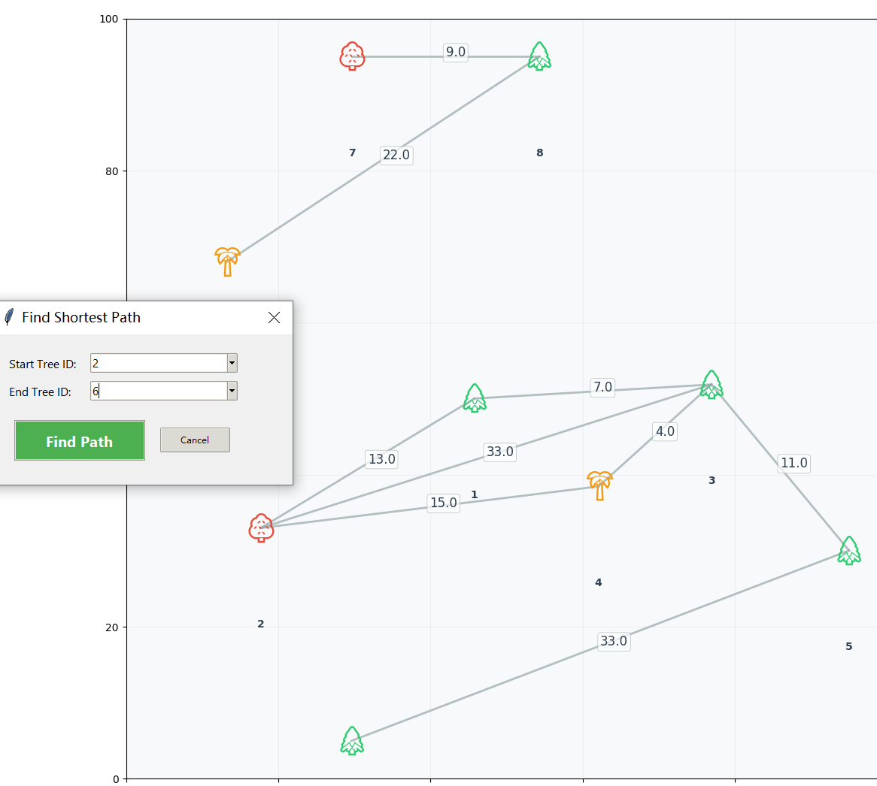
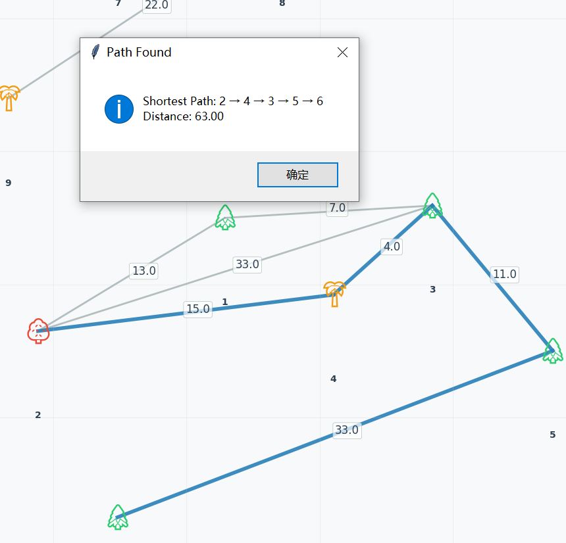
🖥️GUI(Path Finding)
Select path
Find the path

Slide 23
🖥️GUI(Path Finding)
Why Dijkstra?
Handles Weighted Graphs:
Dijkstra’s algorithm is designed to find the shortest path in graphs where edges have different weights (distances or costs). This matches the forest scenario, where the distance between trees may vary.
Guarantees Optimality:
Dijkstra always finds the true shortest path from the start node to every other node, as long as all edge weights are non-negative.
Efficient for Sparse Graphs:
With a priority queue (min-heap), Dijkstra is very efficient, especially when the graph isn’t too dense.

Slide 24
🖥️GUI(Path Finding)
Why priority queue (min-heap)?
Always Expand the Closest Node:
The priority queue ensures that, at each step, the algorithm processes the node with the currently smallest known distance. This is the core of Dijkstra’s logic.
Efficiency:
Using a min-heap allows for fast retrieval and updating of the next node to process, keeping the algorithm’s time complexity low (O((V+E)logV)).

Slide 25
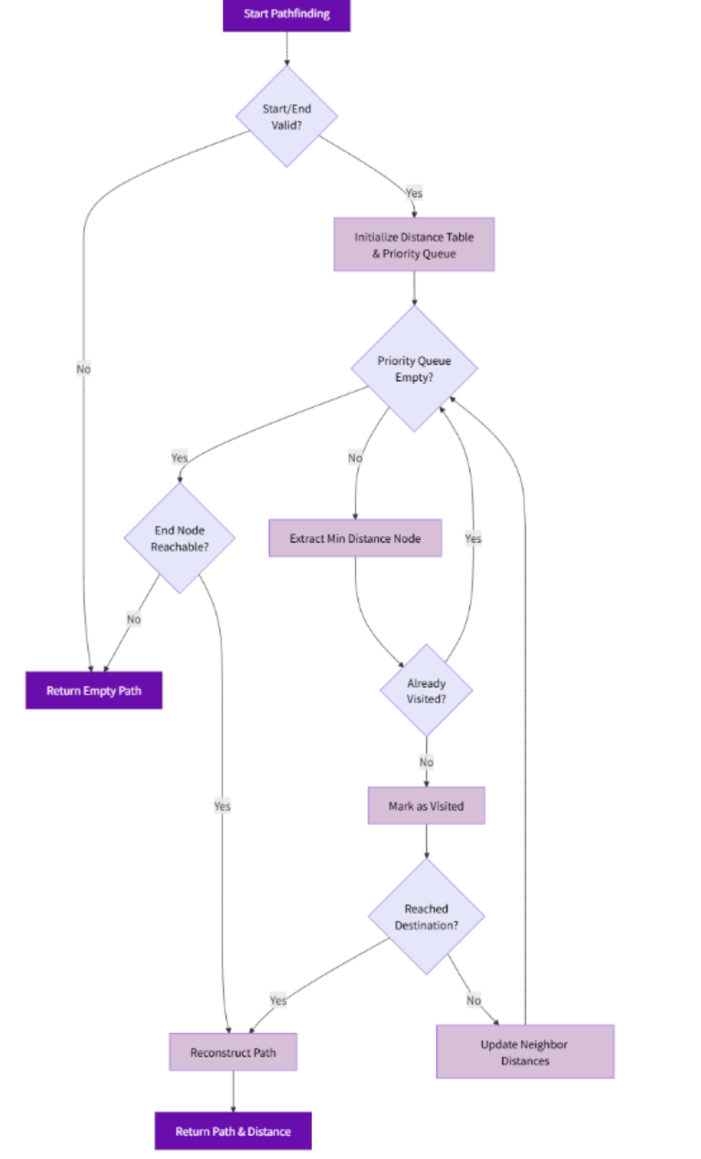
Path Finding
Start:
Check if start/end nodes exist.
Init:
Set start distance=0, others=∞ Use min-heap: [(0, start)].
Loop:
Pop closest node from heap.
If visited, skip; else mark visited.
If reached end, backtrack path.
Update neighbors' distances, push to heap if improved.
End:
If heap empties unreached → no path.

Slide 26
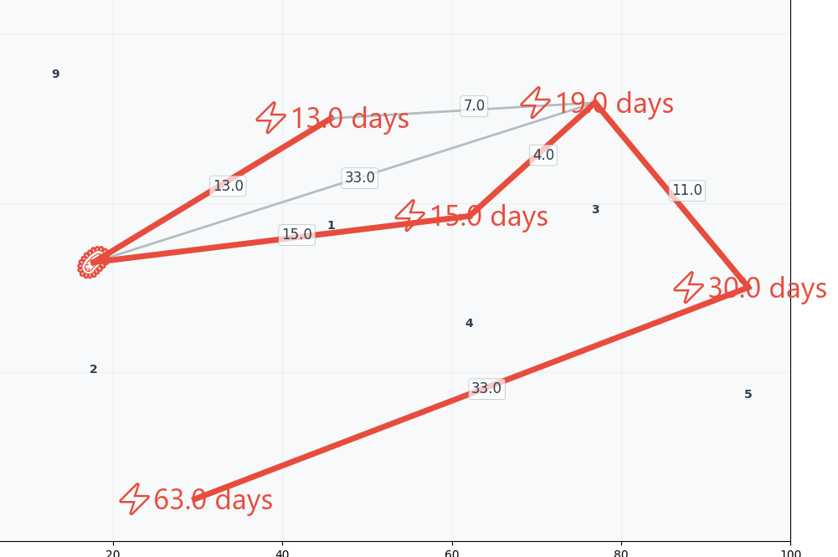
🖥️GUI(Infection Simulator)
Select the infect tree (selecting other trees will cause an error) to infect the user through the Distance-based priority queue, exit the emulator and return to normal
Units are
roughly estimated based on weights

Slide 27
🖥️GUI(Infection Simulator)
Why not use BFS for infection? Why use a Distance-based priority queue?
BFS is for equal steps:
BFS works well if every tree takes the same time to get infected (for example, 1 day for each tree).But if some trees are closer and some are farther, BFS cannot tell which tree gets infected first.
Priority queue is for different times:
In a real forest, some trees are close, some are far. A priority queue always picks the tree that will be infected the soonest. This makes the infection order correct.
Like Dijkstra’s algorithm:
This method is like Dijkstra’s algorithm, which always finds the fastest way.

Slide 28
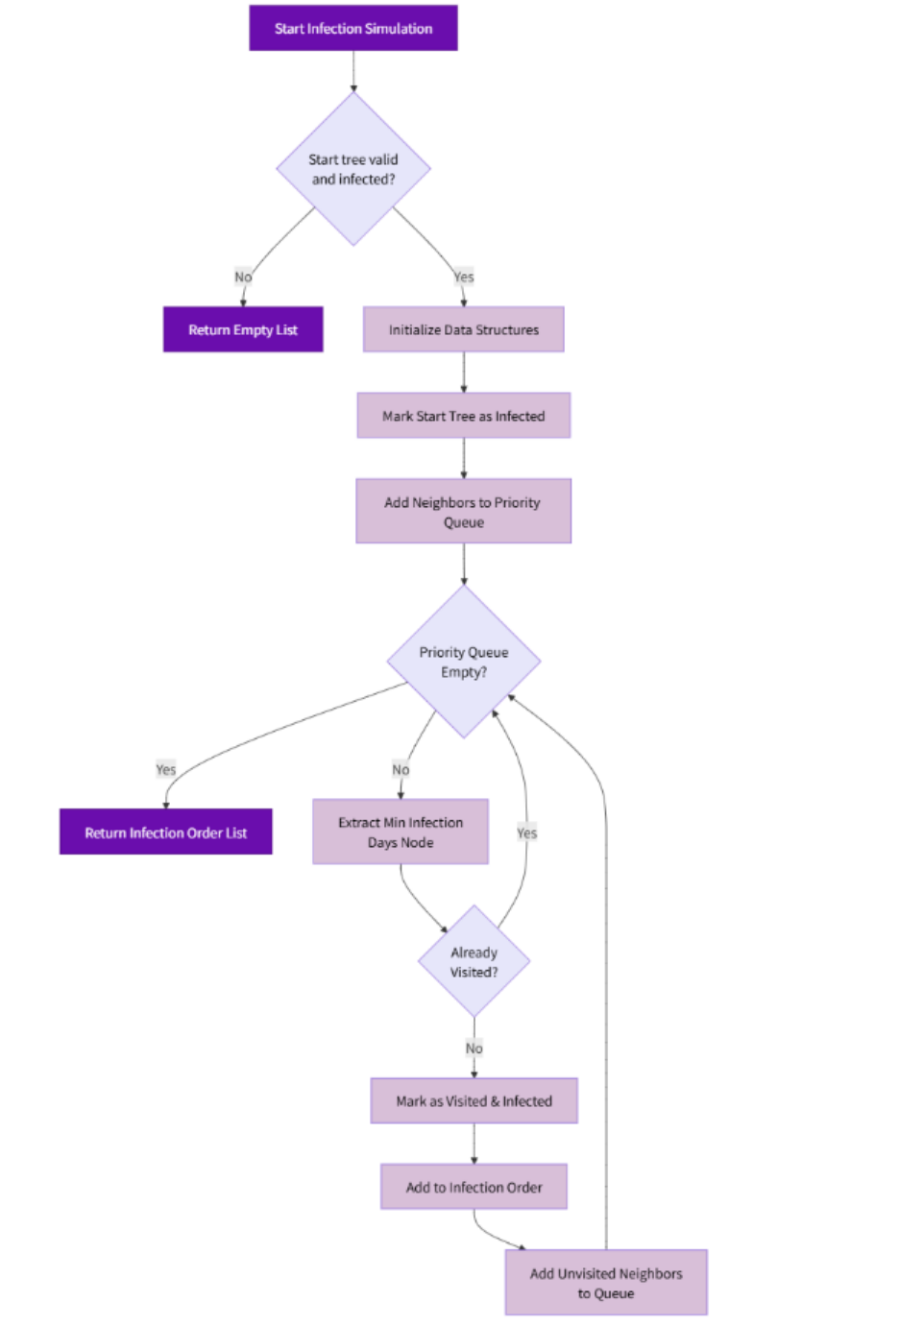
Infection Simulator
Start:
Validate infected starting tree
Init:
Begin tracking from start Prepare processing queue
Spread:
Always infect nearest tree first
Record when each tree gets infected
Schedule neighbors for later infection based on distance
Complete:
Finish when no more trees can be infected
Return full infection timeline

Slide 29
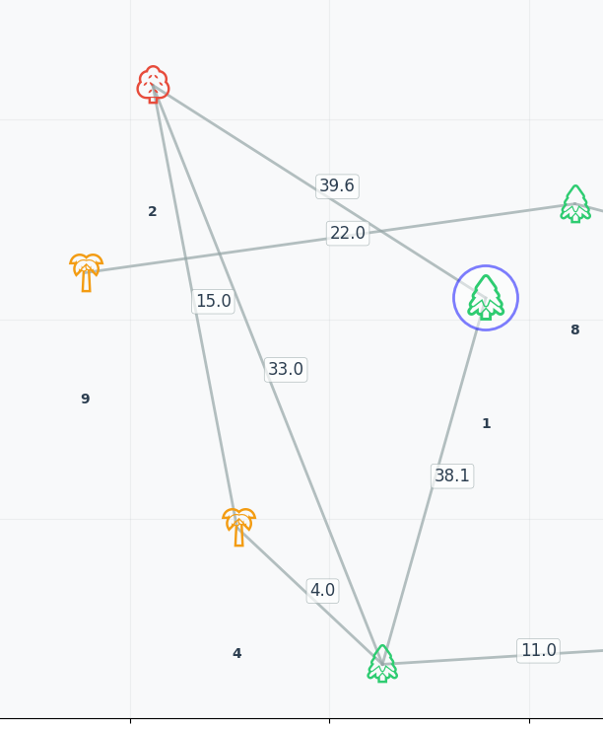
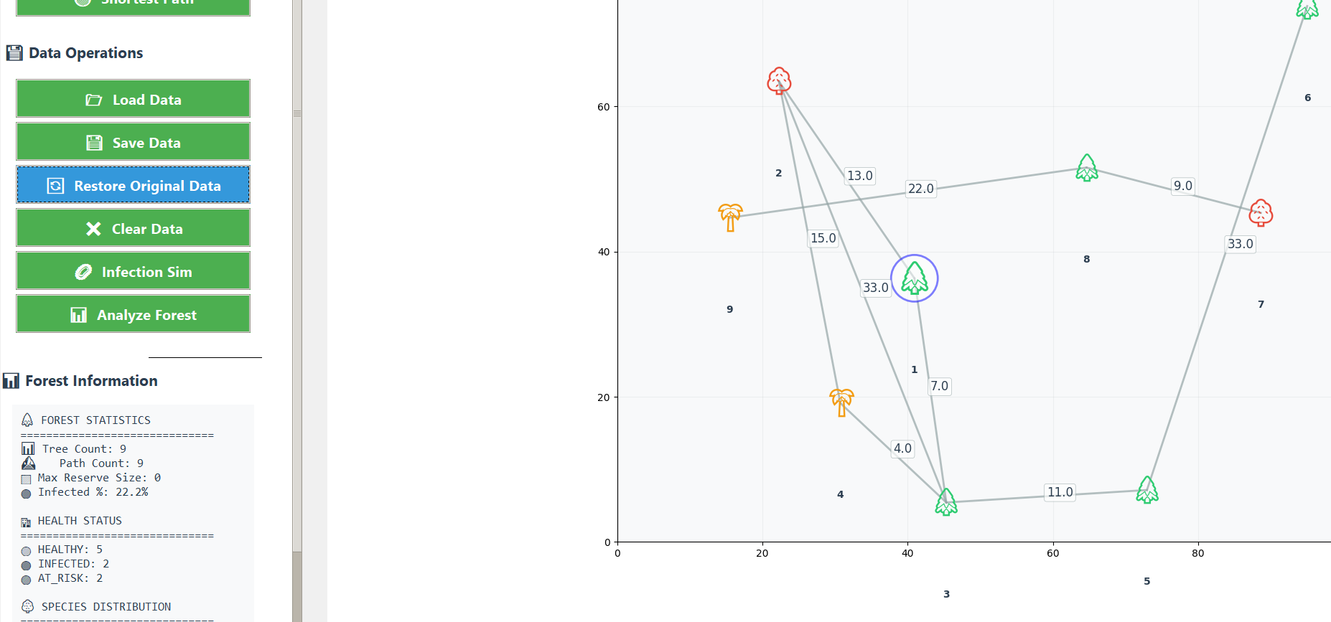
🖥️GUI(Force-Directed Layout)
restore

Slide 30
🖥️GUI(Force-Directed Layout)
Why Force-Directed Layout?
Make the node layout more beautiful
The force-directed algorithm lets the trees (nodes) automatically spread out and not overlap, making the whole structure clearer and better looking.
Show real relationships
Nodes that are closely connected will be closer together, while weakly connected nodes will be farther apart. This visually shows the relationships between trees in the forest.

Slide 31
Adjacency list
Why Adjacency list?
Memory Efficiency: Forest paths are typically sparse (most trees connect to only a few others), making adjacency lists much more memory-efficient
Performance for Common Operations: Finding neighbors of a specific tree is O(1) with our implementation
Scalability: Adjacency lists handle large forests better when connections are sparse
Flexibility: Easy addition/removal of trees and paths without restructuring the entire data structure

Slide 32
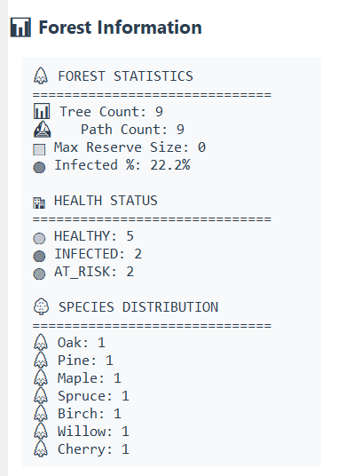
🖥️GUI(Data Analysis)
For visual display, we visualized the information data in the picture on the right

Slide 33
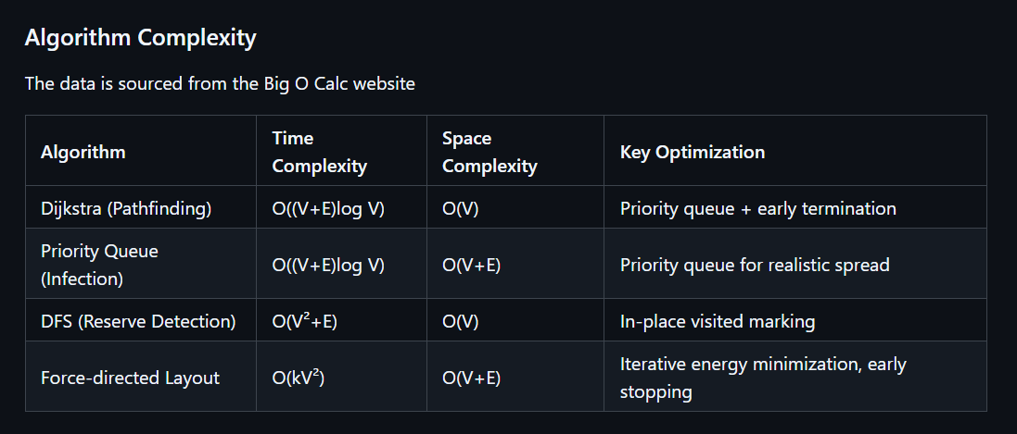
Algorithm Complexity⏲

Slide 34

Technical Highlights

Slide 35
Technical Highlights 💡
🌳 Dynamic Visualization: Real-time tree repositioning with drag-and-drop and automatic path weight updates
🔄Interactive Simulation: Visualizes disease spread patterns and reserve boundaries
⚡Optimized Adjacency List: Enables O(1) neighbor lookups and distance calculations
🎛️Force-Directed Layout: Specifically for initial tree positioning from CSV data
🧩Modular Plugin System: Easy integration of new features

Slide 36

Difficulties faced and solved

Slide 37
Difficulties faced and solved ⚡
Testing Challenges 🧪
Extensive manual & coverage testing consumed significant time
Iterative testing improved robustness
Resolved issues through module-by-module code inspection
Performance Optimization ⚡
Initial algorithms had high time/space complexity (mid-term review feedback)
Implemented adjacency lists for efficient data handling
Cross-Platform Compatibility 🌐
Addressed through detailed code annotations
Improved documentation based on mid-term evaluation feedback
Modular Architecture 🧩
Restructured files by functional features
Incorporated teacher's suggestions for better encapsulation
UI Enhancement 💻
Enriched interactive popups and edge cases
Expanded test set coverage

Slide 38
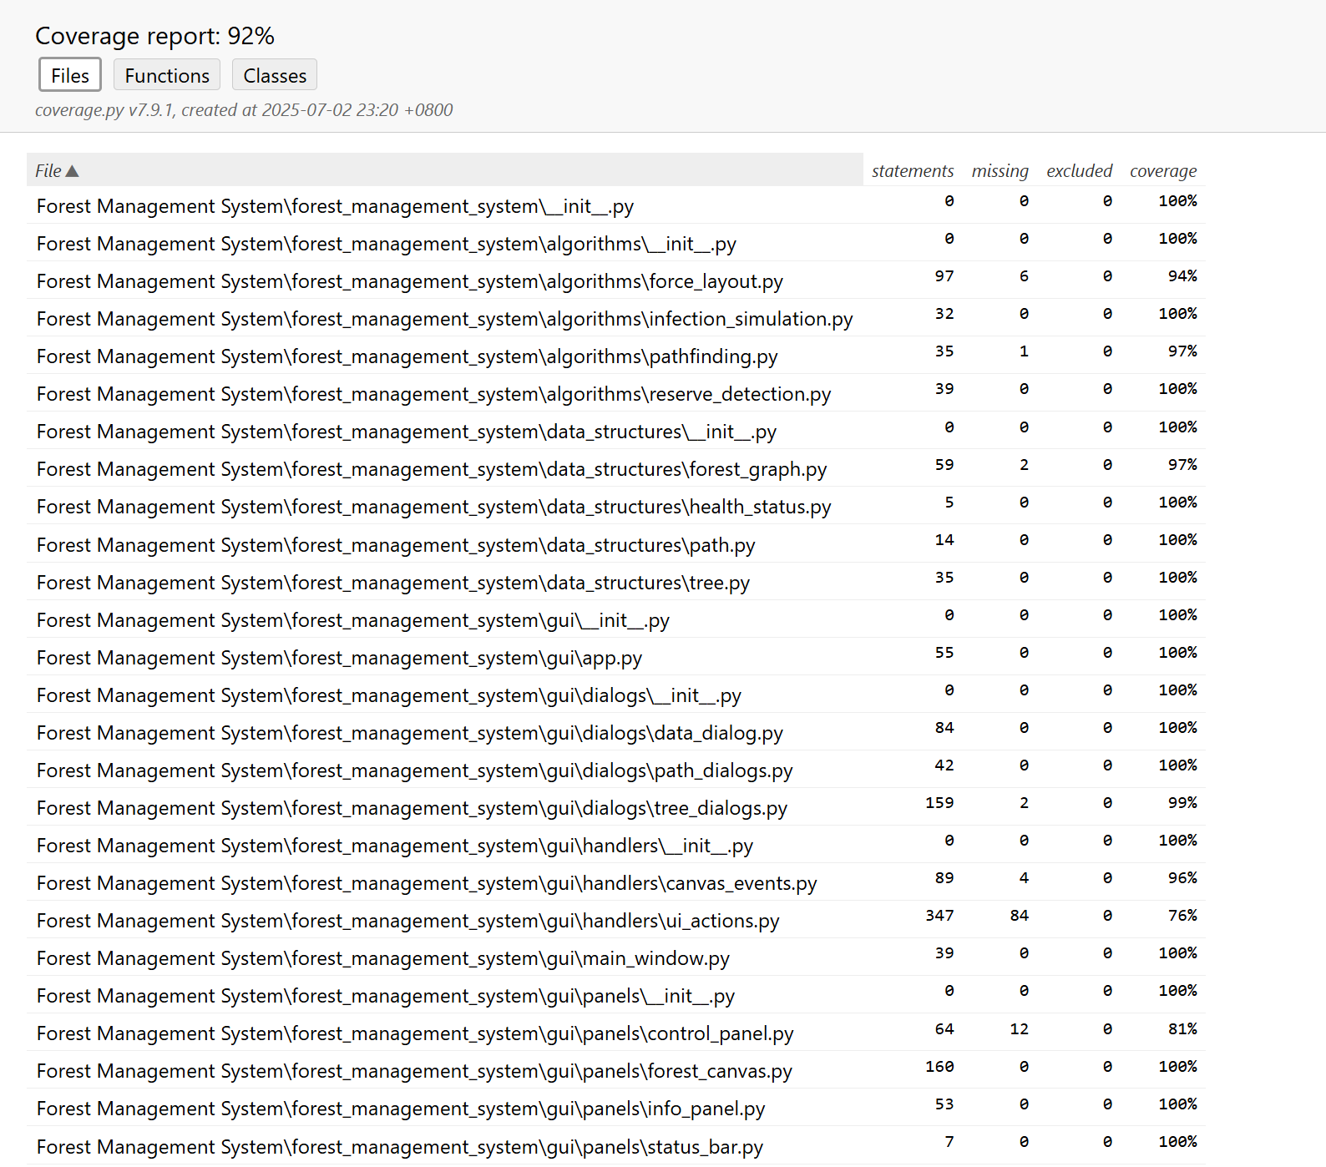
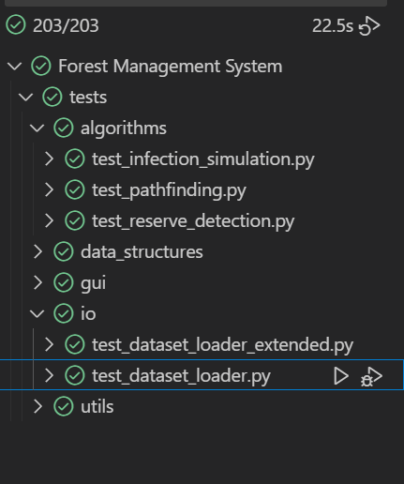
Test Coverage Percent ⚡

Slide 39
Future Prospects

Slide 40
Future Prospects🌐
What's Next?
🔹 Search trees → Quick sorting by tree type/age
🔹 AI helper → Get automatic care suggestions

Slide 41
Project Summary

Slide 42
Project Summary🧩
This forest management system represents our most complex and time-intensive project to date. Through this hands-on experience, we gained valuable technical and engineering insights.
We successfully implemented graph theory algorithms like Dijkstra's shortest path and DFS detection. Building the complete system - from core algorithms to visualization - deepened our understanding of practical software development.
The project taught us how technical implementation, system design. These hard-won lessons will continue to guide our growth as developers.

Slide 43
Thank you for your attention and valuable guidance!
Merci beaucoup!🎇

